Slide 1
INSTITUTE OF DATA MINI PROJECT 1
Predicting red wine quality
Monica Estrada
6 February 2021
“Making good wine is a skill, making fine wine is an art”
Robert Mondavi

Slide 2
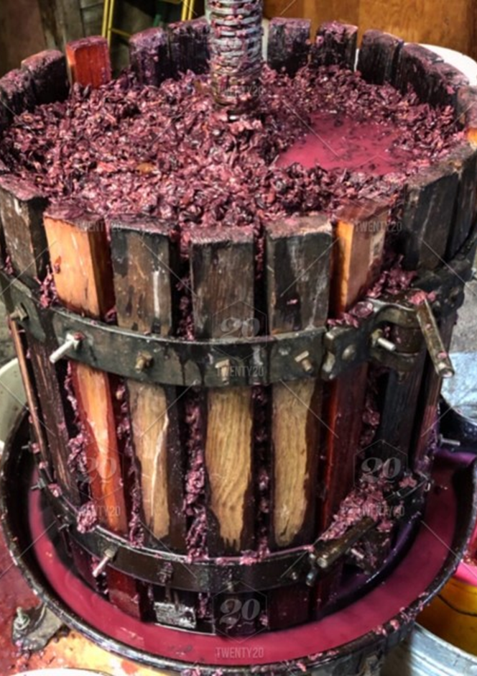
Wine industry context
Value:
Global market valued at $355 billion US (2018). Australian valued at $45.5 billion (2019).
Drivers:
Increasing demand (health benefits & premium options), flavour innovation, & advanced distribution networks.
Customers’ changing preferences are driving industry grow.
Investing in new technologies for the making & selling process.

Slide 3
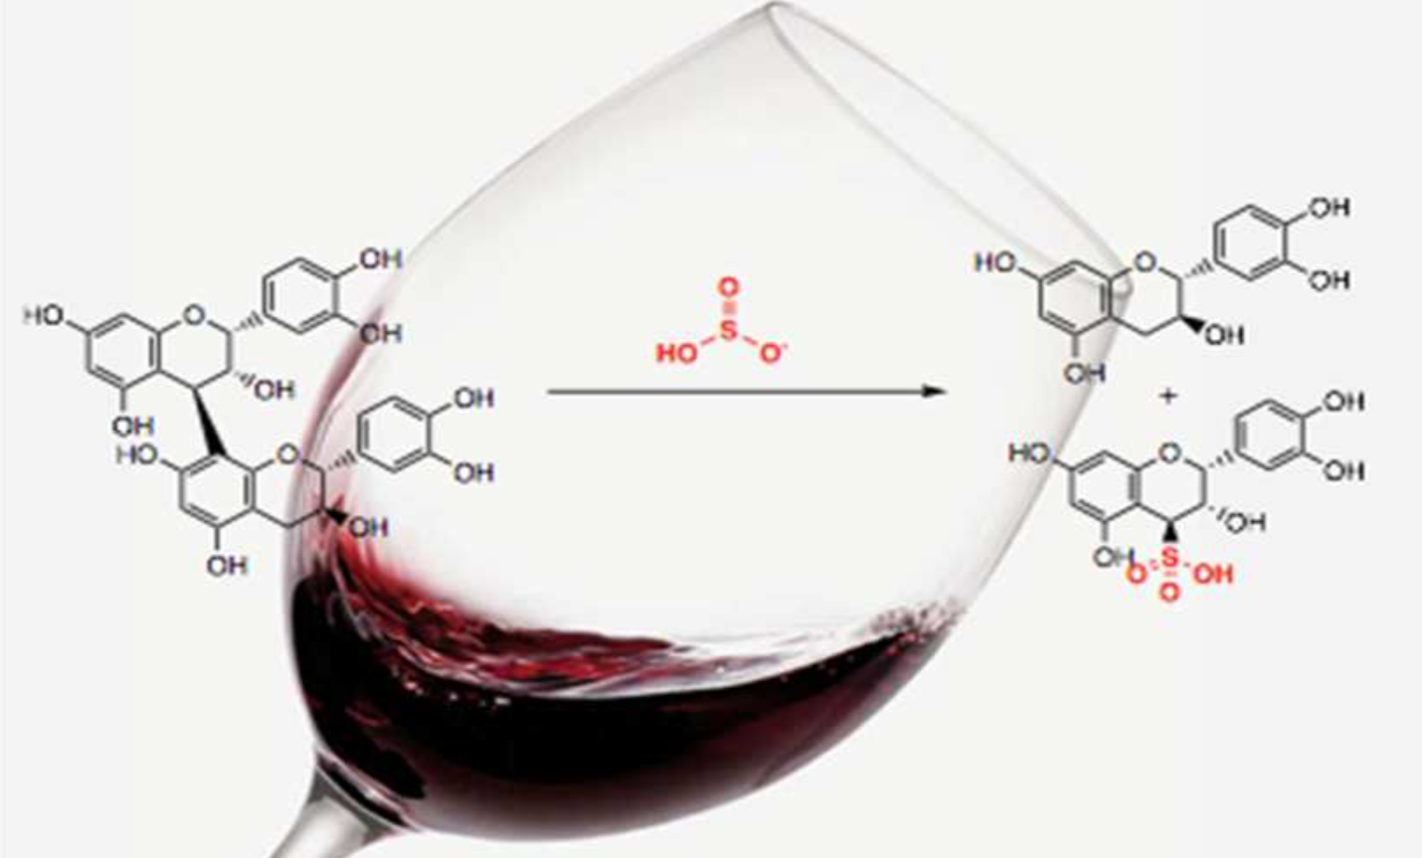
Business question
What makes up a good wine?
What are the most important parameters affecting the quality of red wine?
What are the main differences between a bad and a good red wine quality?

Slide 4
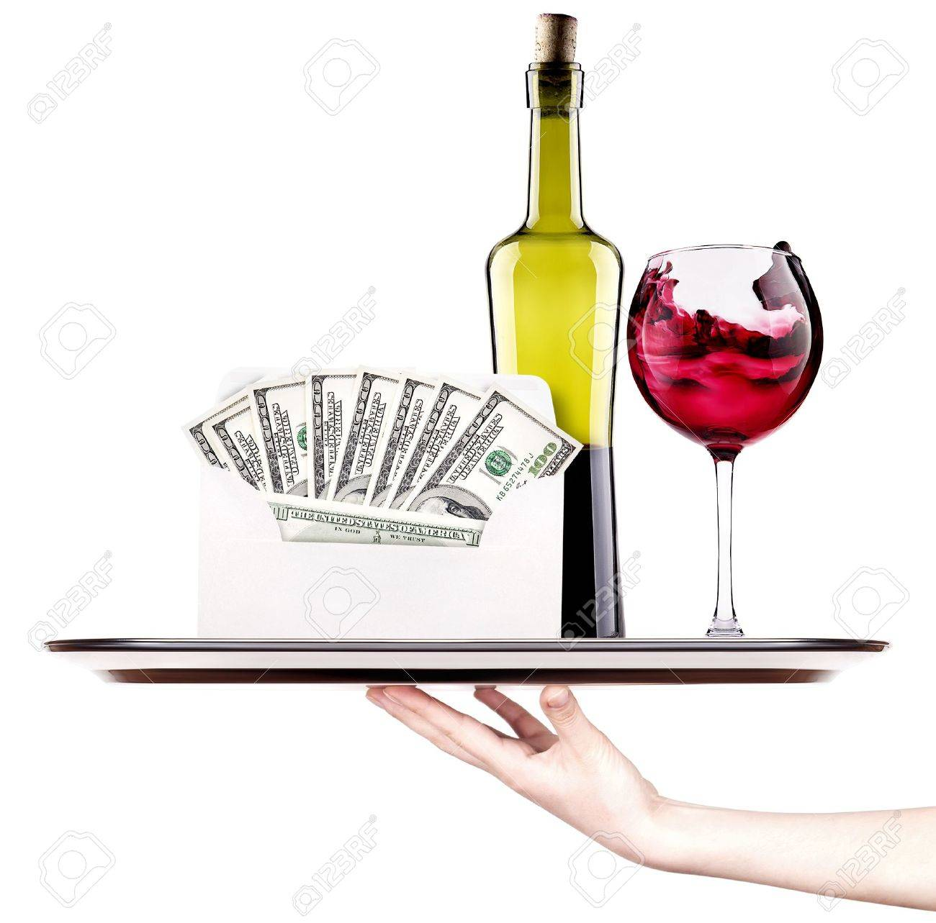
Importance of the question
The answer of these questions can help wine makers to improve their wine quality and increase revenue.
Data analysis techniques assist unearthing insights that are helpful in predicting wine quality and fruitful for economic & financial performance.

Slide 5
Pipeline
Prepare
Deliver
Exploration
Profiling
Cleaning
Transforming
Assess ability to answer questions
Data acquisition
Business questions
Strategy
Revision
Determine feature variables
Predict
Visualise
Interpret
Summarise
Communicate
Define
Analyse

Slide 6
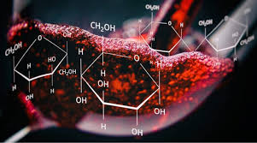
Quality assessment
Used to improve making & stratification.
Based on: physicochemical parameters (lab tests) or sensory tests (human experts).
Relationship between physicochemical and sensory analysis is complex & still not fully understood.

Slide 7
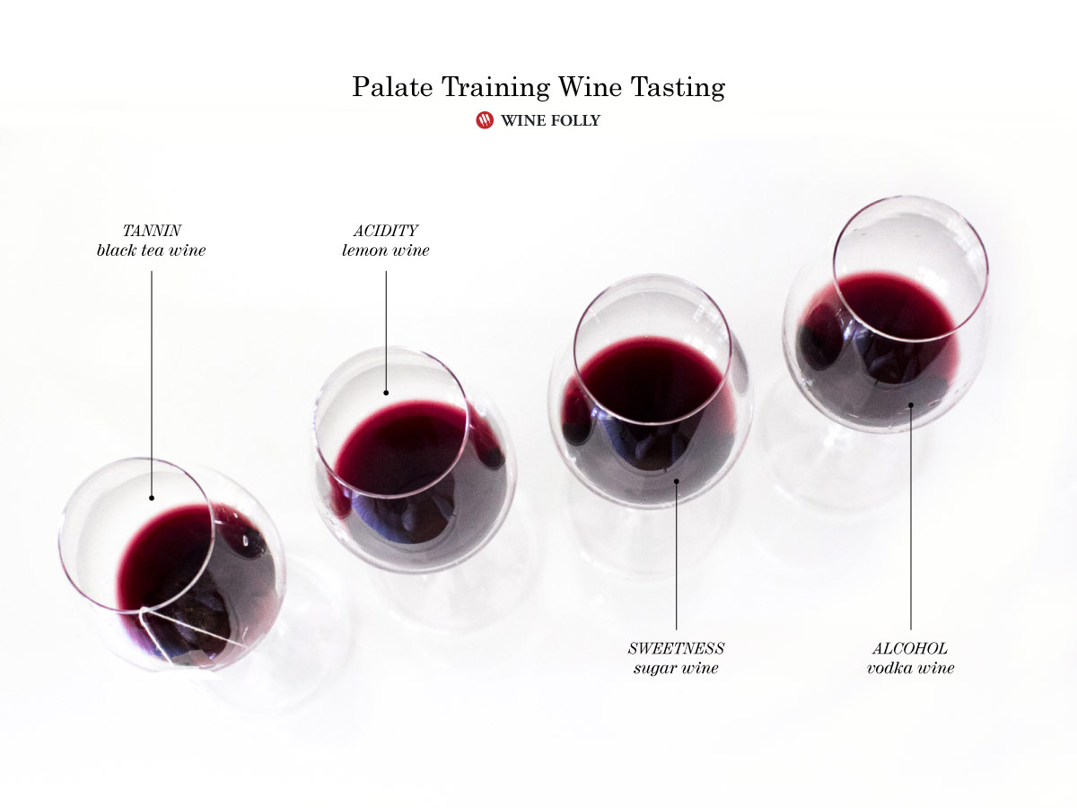
Dataset
Red wine quality*
1599 records (after 1179)
11 Features (predictors): physicochemical parameters
One output (response), quality score based on sensory data
The model can be used to predict wine quality.
*Reference: P. Cortez, A. Cerdeira, F. Almeida, T. Matos and J. Reis. Modelling wine preferences by data mining from physicochemical properties. In Decision Support Systems, Elsevier, 47(4):547-553. ISSN: 0167-9236.

Slide 8
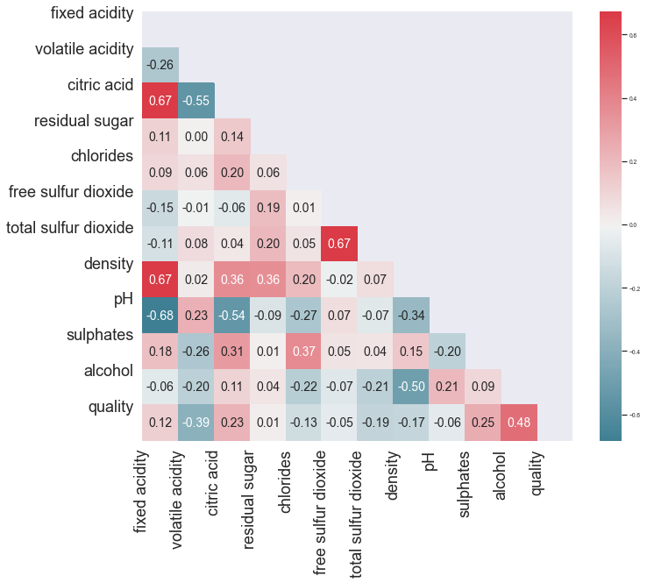
Correlation between the different variables
There is weak to moderate correlations (linear relations) between the variables

Slide 9
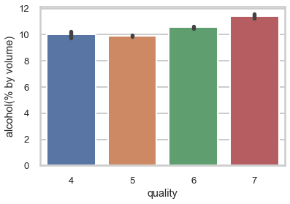
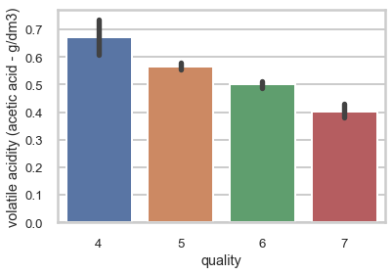
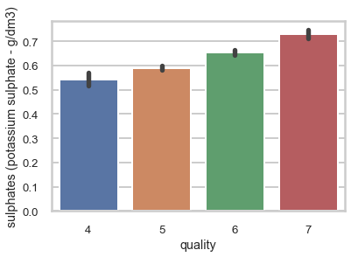
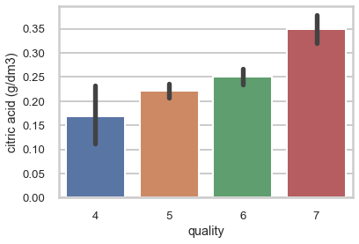
Main Attributes (Predictors) vs. Quality (Response)
Alcohol
wine sensory sensations
interaction with other components (aromas, tannins)
influence in viscosity and body, perception of astringency, sourness, sweetness, aroma, and flavour
Helps balance sweetness and acidity
Volatile acidity
important sensory parameter, with higher levels indicating wine spoilage
too high levels can lead to an unpleasant, vinegar taste
affects taste in wine (sourness if too high and dense if too low)
Sulphates
used as preservative, acts as antimicrobial, and prevent oxidation
Affect aroma and flavour
Citric acid
can impart specific flavours and additional acidity to wine
in small quantities can add 'freshness' and flavour

Slide 10
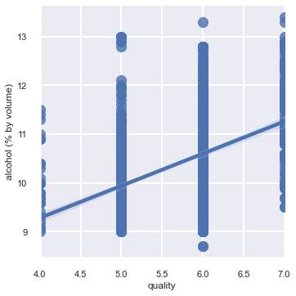
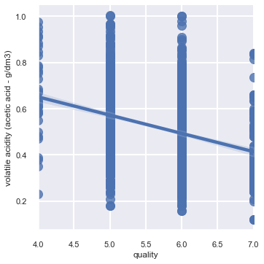
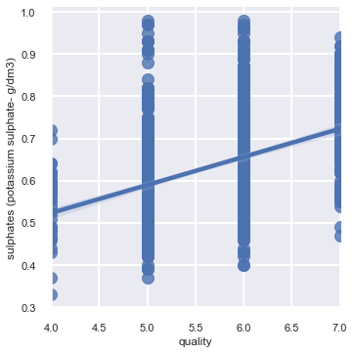
Key findings: Comparing main attributes (predictors) against response(quality)
Moderate + Correlation
Moderate - Correlation
Moderate + Correlation
Alcohol increases when wine quality increases (+0.49)
Volatile acidity decreases when quality increases (-0.35).
Sulphates increases when wine quality increases (+0.42).

Slide 11
Conclusions and next steps
“Wine, like life, is meant to be enjoyed”
Richard Branson
Conclusions:
The data analysis assessed how chemical components contribute to the quality of red wine and how this knowledge can we used to grade the quality level.
This can assist the wine maker in distinguishing factors affecting quality and setting reasonable prices.
Red wine high quality tends to have: less volatile acid, more citric acid, more alcohol, more sulphates, less chlorides, and not too much and no too little free sulfur dioxide.
Good wine quality could be predicted based on alcohol, volatile acidity, sulphates and acid citric concentrations.
Next steps:
Further analysis by employing linear regression.
Generation of a model to highlight significant attributes helpful in prediction for production of high quality wine.

Slide 12
Any questions?

